Slide 1
Data Hackthon Problem on Shopping Trends – Analysis of Consumer Purchasing Behaviors
Objective:
- Analyze consumer purchasing behaviors to uncover actionable insights.
- Enhance marketing strategies, boost customer retention, optimize inventory, and improve channel performance.
Submitted by – Palak Agrawal
Date – 24-Jan-2025

Slide 2
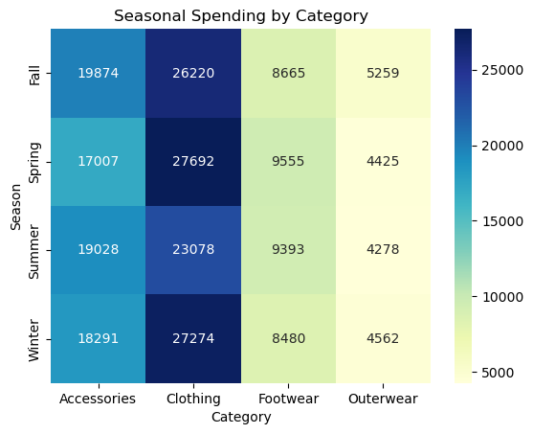
Enhancing Marketing Strategies
>>Metrics to Analyze:
a.Total Spending: Customers spending the most.
b.Frequency of Purchases: Customers making frequent purchases.
c.Preferred Categories: Popular product categories among high spenders.
d.Demographics: Age, gender, or location of high-value customers
>>Insights to Derive:
1.Create exclusive promotions for top categories like "Clothing" .
2.Incentivize high-value customers with loyalty rewards to boost retention.

Slide 3
Boosting Customer Retention
>>Key Insights-
Subscribers contribute significantly to revenue and purchase more frequently.
Non-subscribers are price-sensitive but offer conversion potential.
>>Recommendations-
Develop loyalty programs for subscribers.
Deploy targeted campaigns to convert non-subscribers into subscribers by emphasizing the value of subscription benefits (e.g., discounts, priority services).
Develop targeted promotions for non-subscribers to encourage repeat purchases and increase their lifetime value.
Metric | Subscribers | Non-Subscribers
Revenue Strategy | Promote premium subscription benefits. | Highlight value and upsell subscriptions.
Engagement | Reward loyalty with exclusive perks. | Use personalized offers to drive conversions.
Retention | Offer tiered loyalty and referral incentives. | Re-engage via promotional and seasonal campaigns.

Slide 4
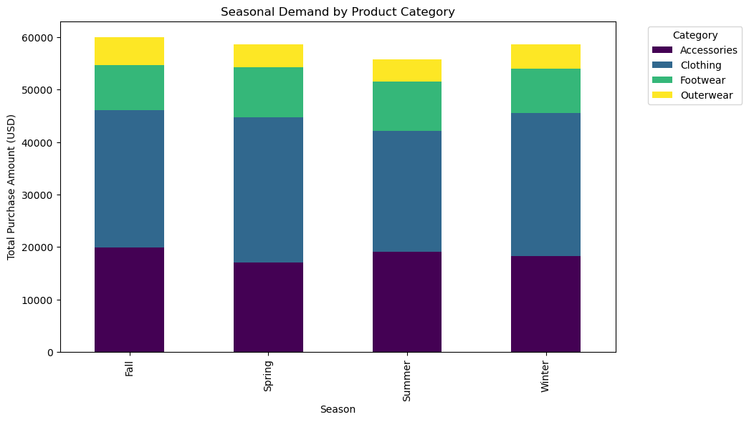
Optimizing Inventory Management
>>Key Insights:
Seasonal demand trends highlight peak times for different categories.
Forecasting supports efficient inventory planning.
>>Recommendations:
Seasonal Peaks: Allocate higher inventory for categories like "Clothing" during Winter and spring because sales spike during that season.
Category Trends: Maintain consistent stock for top-performing categories like Clothing across all seasons.
Actionable Inventory Planning: Replenish stocks just before seasonal peaks.

